Slide 1
Capstone Project Review - I
Project Title : Style-Consistent Kannada Font Generation
Project ID : PW21KS04
Project Guide : Prof. K S Srinivas
Project Team : 1. Saahil B Jain - PES1201700241
2. Jeevana R Hegde – PES1201700633

Slide 2
Outline
Problem Statement
Motivation/Background study
Proposed Solution/Methodology
Software/Hardware/Data Requirements
Expected Deliverables
Capstone (Phase-I & Phase-II) Project Timeline
Any other information

Slide 3
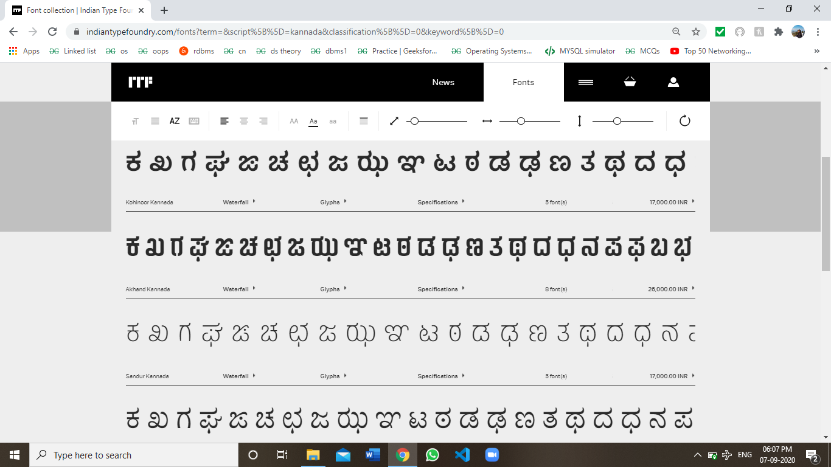
Problem Statement
Problem statement:
The project is to automate the generation of new fonts for the Kannada scripts while simultaneously ensuring generation of maatras.

Slide 4

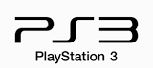


Motivation/Background Study
Motivation:
Logo fonts can make or break your logo design.
Eg: Disney, Netflix, The Times of India, etc.
With continuous advancements in web-technologies and the need to deliver a great experience to non-English speaking users is creating a greater demand for high-quality, multi-script typefaces.

Slide 5
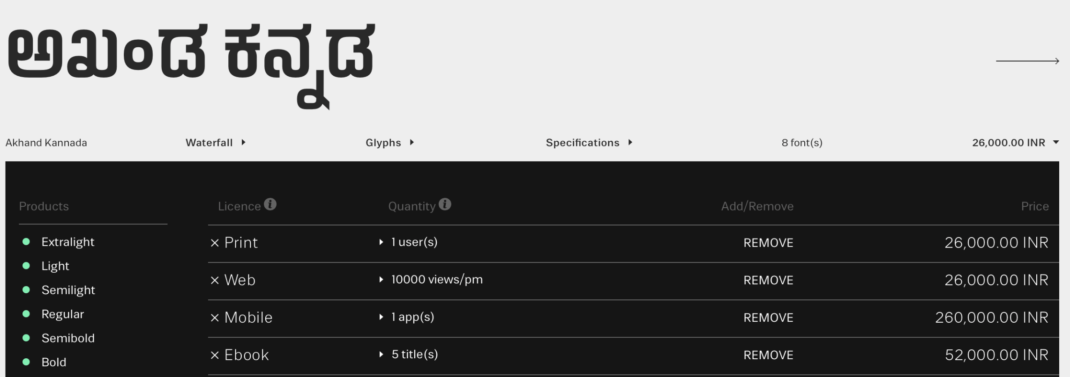


Motivation/Background Study
Background study:
Indian Type Foundry (ITF) is a company which manually creates customized fonts for various languages.
The charges range from 26,000INR - 2,60,000INR for a specific typeface.

Slide 6


Proposed Solution/Methodology
Proposed Solution/Methodology
Work done in this field:
Commercial font generation is currently done by designers by manually sketching each letter using design tools.
Pros:
Customized to user requirements.
Cons:
Time consuming
Expensive

Slide 7
Proposed Solution/Methodology
Work done in this field:
GlyphGAN [4] was a paper proposed in 2019 which is based on GANs to generate style-consistent fonts for English language.
Pros:
Method | Recognition accuracy [%] (Legibility) | Cs (Style consistency) | Cd (Diversity)
Deep-fonts | 72.51 | 0.47 | 0.33
GlyphGAN | 83.90 | 0.46 | 0.61
Cons:
GANs require an extremely large variety (about 6561 different typefaces) of fonts to learn and further create new fonts.
This is unavailable for Indian languages such as Kannada.
Hence the new approach.

Slide 8
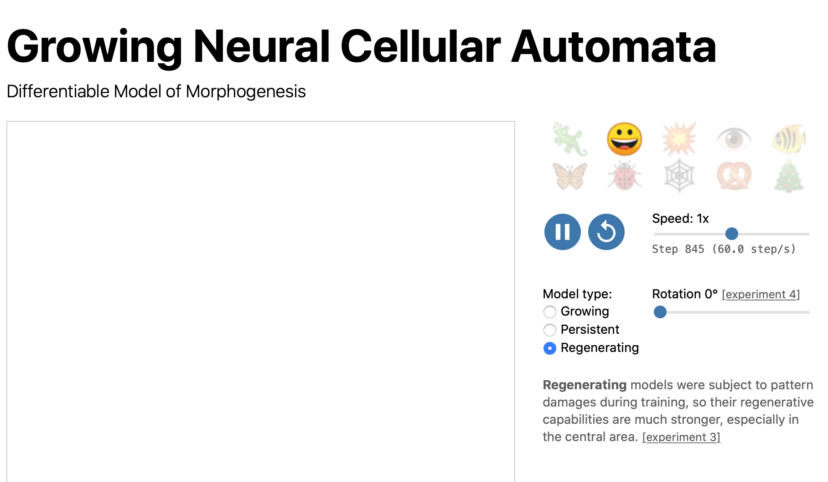
Proposed Solution/Methodology

Slide 9
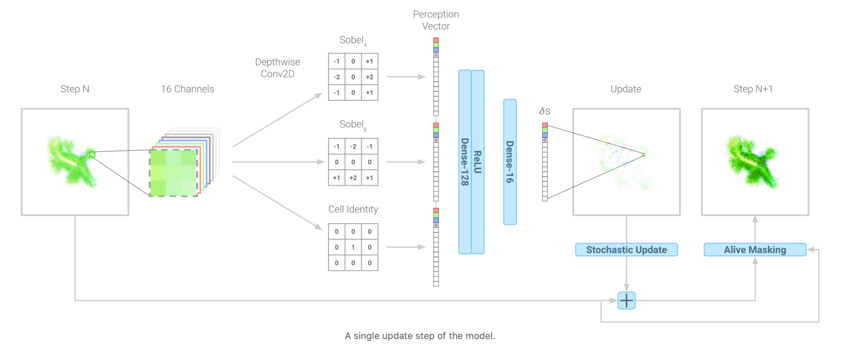
Proposed Solution/Methodology
Proposed architecture:

Slide 10
Proposed Solution/Methodology
Proposed Solution/Methodology
Proposed solution:
We plan to use Neural Cellular Automata to solve the problem statement.
We will represent each cell state as a vector of 16 real values.
Then we learn an update rule for each cell using its neighbours.
Applying this update rule multiple times will help generate the given font.
Slight moderations in the feature extraction can result in unique fonts.

Slide 11
Software/Hardware/Data Requirements
The technologies / platforms/ languages used:
Machine learning
Cellular automata
Python
Google Colab/Kaggle Notebook
The Software Engineering methodologies to be used:
Agile
Data requirement:
Kannada language alphabets and digits dataset.

Slide 12
Expected Deliverables
Capstone-I deliverables:
To learn and generate the cellular automata of every letter and digit of the Kannada language.
Capstone-II deliverables:
To uniformly moderate the font of each letter and digit of Kannada language.
To create a generalised model to accept dataset of any language and provide various automated fonts.

Slide 13
Capstone (Phase-I & Phase-II) Project Timeline
Gantt chart to provide project deliverable timeline:
WEEK 1 | WEEK 2 | WEEK 3 | WEEK 4
Literature survey on problem statement. | Literature survey and definite problem formulation. | Literature survey on proposed architecture. | Obtaining and cleaning dataset.
WEEK 5 | WEEK 6 | WEEK 7 | WEEK 8
Developing hidden channel & feature extraction. | Build basic model of Neural Cellular automata for a single letter. | Build basic model of Neural Cellular automata for a single letter. | Build basic model of Neural Cellular automata for all letters.
WEEK 9 | WEEK 10 | WEEK 11
Incorporating maatras for every letter. | Fine tuning and documentation. | Fine tuning and documentation.

Slide 14
Any other information
References
Article in Online Encyclopedia
[1] Alexander Mordvintsev, Ettore Randazzo, Eyvind Niklasson, Michael Levin, “Growing, Neural Cellular Automata”, Feb. 11, 2020. [Online],
Available: https://distill.pub/2020/growing-ca/ [Accessed Sep. 02, 2020]
Journal Article Abstract
[2] Koen Janssens, “Network Cellular Automata—A Development for the Future?”, Computational Materials Engineering, 2007. [Online], Available:
https://www.sciencedirect.com/topics/computerscience/cellularautomata [Accessed Sep. 03, 2020]
E-books
[3] Gavin Andrews, Cellular Automata and applications. [E-book] Available: https://www.whitman.edu/Documents/Academics/Mathematics/andrewgw.pdf
Research paper
[4] Hideaki Hayashia, Kohtaro Abea, Seiichi Uchidaa, GlyphGAN, Department of Advanced Information Technology, May 30, 2019. Available:
https://arxiv.org/pdf/1905.12502.pdf [Accessed Sep. 04, 2020]

Slide 15
Thank You

